Slide 1
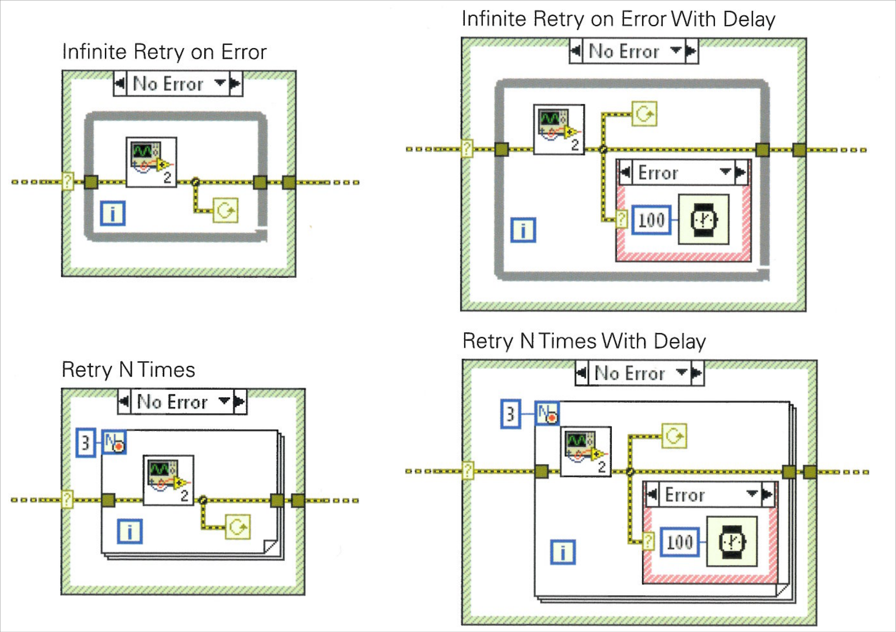
LabVIEW Errors Deep Dive
“What more can be said about a cluster that contains a Boolean, an I32, and a string?”
Screenshot of: NI LabVIEW Error Responses.pdf
Event: GDevCon #5 (Stuttgart, Germany)
Date: Thursday, 12 September 2024

Slide 2




Presenter
Petru Tarabuta MEng MIET | Test System Engineer
Contact Details
Email: petru@robustosystems.com
Tel: 01452 452 165
Robusto Systems Ltd (UK)
www.robustosystems.com
Notes:
I am originally from Romania. I went to university in the UK and have lived and worked in the UK ever since. I am helping customers implement test, measurement, and control systems through my company, Robusto Systems.
It is an honour and a pleasure to present at GDevCon.
Contact Details
Petru Tarabuta MEng MIET CLA CTD CPI | Test System Engineer
Robusto Systems Ltd
petru@robustosystems.com
01452 452 165
www.robustosystems.com

Slide 3
This presentation will describe
What errors are and why they are a useful language feature
The two error categories in a GUI application
Several error handling tips
Several LabVIEW Idea Exchange ideas on how error handling could be improved in future LabVIEW versions
A collection of resources related to errors and error handling
Disclaimer
Errors are a large topic. A comprehensive discussion would require a short book.
This presentation consists of facts and opinions but is not a comprehensive guide.
To keep to time I might have to skip over some of the text in the presentation.

Slide 4
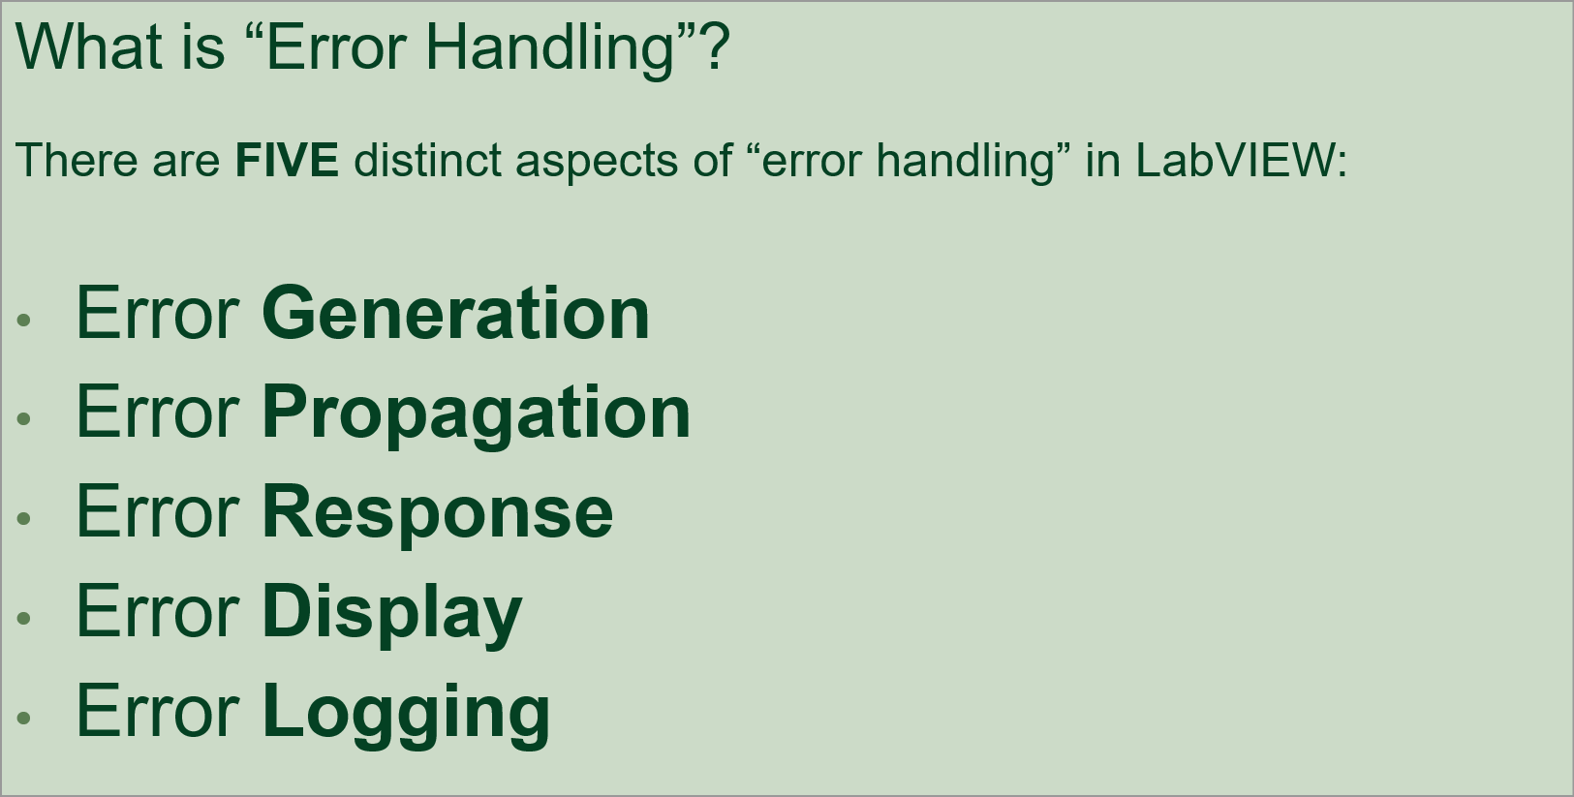
Terminology
Darren Nattinger rightly points out that “Error Handling” can mean many things. This presentation uses “Error Handling” as an umbrella term to designate all aspects of error generation, propagation, and manipulation.
Source: What to Expect When You're Expecting an Error presentation, GLA Summit 2024

Slide 5
What are errors?
Errors are a standardised mechanism for communicating that an operation could not be performed.
There are a large variety of reasons why an operation may fail to execute successfully.
Often it is because an external resource was not available: file does not exist on disk, network connection unavailable, instrument powered off, etc.
Are errors a necessary language feature?
No, errors are not a necessary language feature. The earliest programming languages did not have a standardised mechanism or data structure for reporting errors.
It is theoretically possible to create a working application without using any error handling.
However, errors are an extremely useful language feature. This is why every modern programming language implements the concept.

Slide 6
How was the “operation could not be performed” situation signalled in programming languages that did not natively support errors?
Using primitive data types, such as:
Outputting a Boolean
Outputting an integer (a return code)
Outputting a string (an explanatory message)
Notes:
How was “unable to complete operation” signalled in programming languages that did not support errors?
Outputting a Boolean True if the operation was successful, and a Boolean False if the operation could not be performed.
Outputting an integer, a return code. In most cases, 0 represented “operation executed successfully”; other values represented “operation could not be performed”. The exact non-zero value could be used to identify the reason.
Outputting a string. In most cases, an empty string represented “operation executed successfully”; a non-empty string explained the reason why the operation could not be performed.

Slide 7
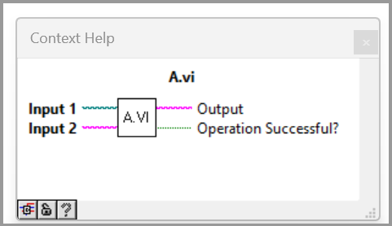
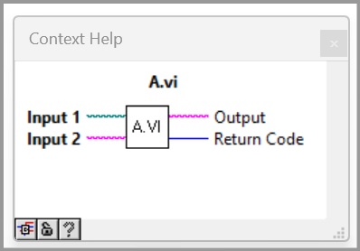
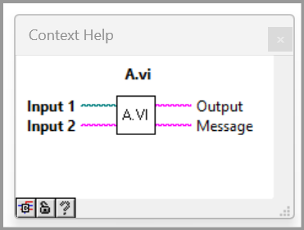
In LabVIEW this could look like:
or
or
or any combination thereof
In early programming languages this led to:
Inconsistent representation between different functions within a codebase
Very inconsistent representation across different codebases
Detecting and handling the “could not perform operation” situation required a variety of coding patterns, each specific to a different way of signalling the situation
A better way was needed.
In LabVIEW, this was the error cluster and error wire.

Slide 8
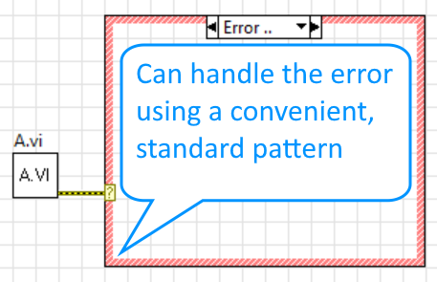
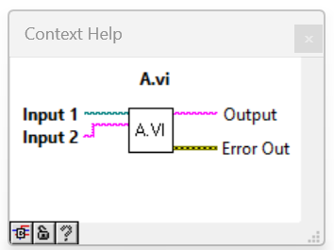
Compare
or
or
Bad
or any combination thereof
With
The Error Cluster and Error Wire represent a standardised way of reporting that something went wrong.
The Error-driven case structure represents a standardised way of handling the situation in downstream code.
Good
Programmers can instantly understand the intent
Clearly separates the “happy case” (no error case) from the “unhappy case” (error case)

Slide 9
Note:
“Operation could not be performed” situations (“file does not exist”, etc.) would occur equally often regardless of whether the language supports an official error mechanism or not.
Not having an official error mechanism would make matters worse.
The error cluster is not the “bad guy”. It is a messenger of something that would have happened anyway.
Since I realised this, I experience a short moment of gratefulness whenever I encounter an error. “I’m glad this undesirable situation was at least reported using a useful, standard mechanism.”

Slide 10
Let’s transition from theory to practice. Let’s discuss some tips.

Slide 11
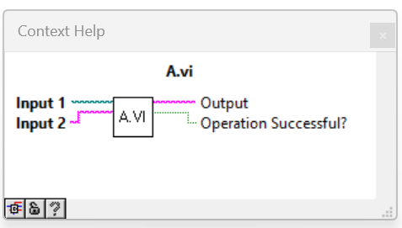
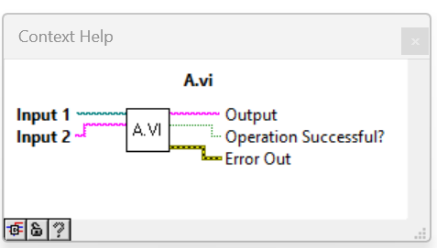
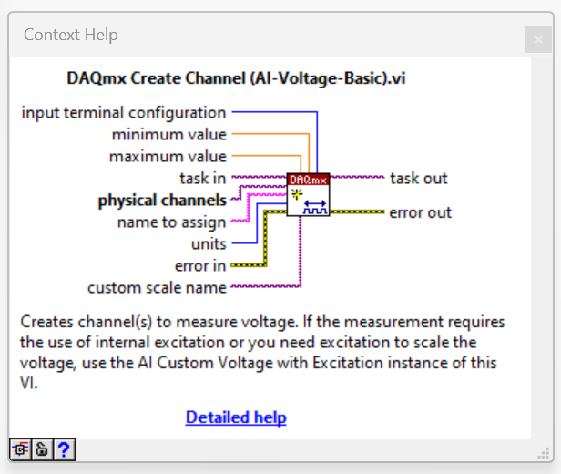
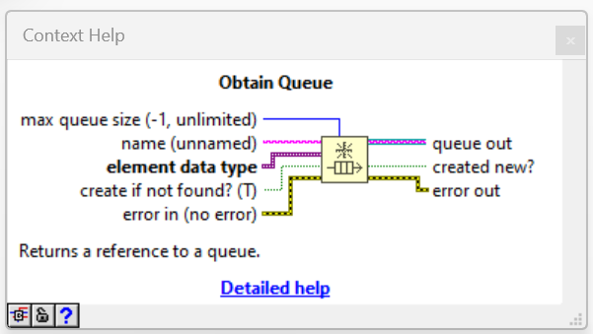
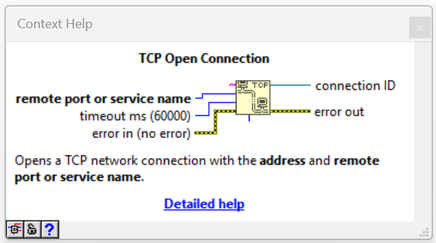
Tip #1: Rely solely on Error Out terminal to indicate that the operation could not be performed.
or
Bad
Good
Notes:
Notice that the Obtain Queue, TCP Open Connection, and DAQmx Create Channel VIs all indicate their success or failure solely through the use of the error out terminal.

Slide 12
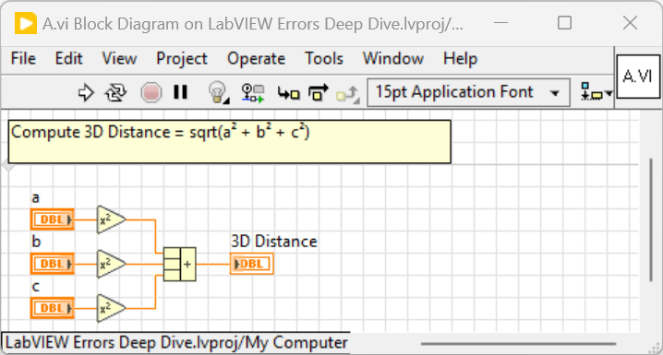
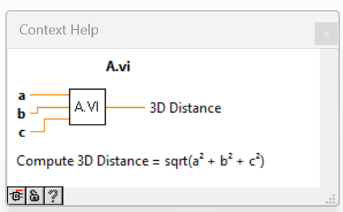
Tip #2: If an operation is guaranteed to run to completion it is usually best to omit Error In and Out terminals.
You may wish to include Error In and Error Out terminals to skip execution if error occurred upstream. This is useful only if the VI execution time is large (>100 ms). There is no need to skip execution of VIs that execute virtually instantly (<1 ms).
Avoid using the Error In and Out terminals solely for the purpose of facilitating execution order in the calling VI. Use Synchronize Data Flow.vim or Flat Sequence Structure instead.
Good
Tip #3: If the VI uses Error In and Out terminals, use the standard 4x2x2x4 connector pane pattern. If it doesn’t, use whichever connector pane suits best.

Slide 13
There are two categories of errors in GUI applications
Category 1: Errors that can occur whether the application contains a bug or not.
These errors are always generated by interaction with external resources. An external resource is anything that is outside of the control of the application, for example: files, network connections, physical instruments. These errors can be referred to as “externally-generated errors”.
These errors were defined by the programmers that created the drivers or APIs that access the external resources.
Externally-generated errors can traverse multiple driver or API layers before they reach the top-level application.
Externally-generated errors are, in a sense, expected. It is to be expected that an external resource may not be available.
Category 2: Errors that can occur only if the application contains a bug. These are known as sanity checks or assertions.
These errors are defined by the programmers who create the GUI application.
Sanity check errors are in a sense unexpected.
Every error originates because a programmer defined this behaviour. Errors do not magically appear at random.
Errors are created intentionally with the purpose of conveying information to the calling layer.
“Every error originates inside an if-else statement.”

Slide 14
Category 1: Externally-generated errors
Tip #4: Externally-generated errors should be handled locally, close to the source of the error. For examples: Retry operation n times, retry indefinitely, or convert error into explanatory user-message such as “Please make sure <filename here> is located in <folder path here>.”
Tip #5: See the NI LabVIEW Error Responses.pdf for several examples of handling errors locally.
Tip #6: Be prepared for externally-generated errors to occur at each and every call to a node or VI that relies on an external resource.
“Errors don’t occur just at Open/Create/Replace File, they can occur whenever you call Read from Text File or Write to Text File.”

Slide 15
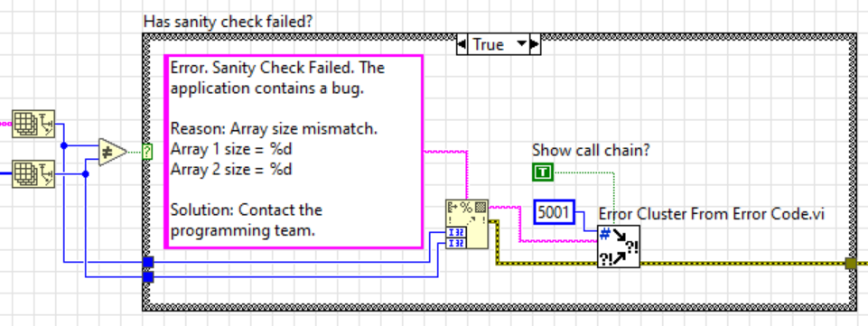
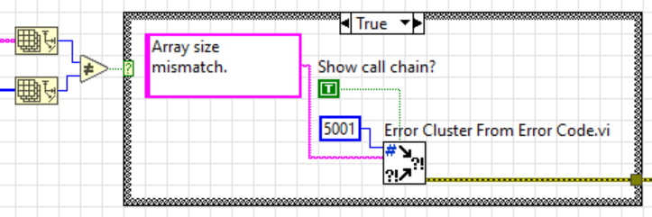

Category 2: Sanity check errors
Tip #7: Sanity checks are a useful defensive programming technique. Do create sanity checks (assertions). They lead to more reliable code.
Tip #8: Sanity check error messages should explain the failure reason in detail.
“A bug identified by an informative error message is a bug half solved.”
Ok
Good
Warning: Creating high-quality error messages can often take longer than implementing the “happy case” functionality on the other side of the check.

Slide 16
Category 2: Sanity check errors (continued)
Tip #9: Sanity check errors should reach the application-wide (global) error handler. It does not make sense to handle or clear these errors locally.
App-wide Error Handlers
Tip #10: Always use an application-wide (global) error handler. Any errors that are not handled locally should be fed to it.
The global error handler should:
Display the error to the user (generally desirable), but it’s useful to be able to turn this off.
Log the error to a log file (virtually always a good idea).
Display a list of all errors that occurred since application started running.
Protect itself against “being spammed”.
What happens if a stray loop reports thousands of errors every second?
Without anti-spam protection this can hang the application and can damage the disk (logging too many errors to file).
The free, open-source Error Manager package could be a good starting point.

Slide 17
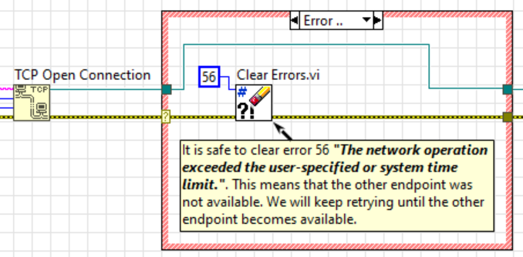
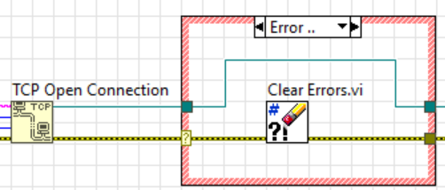
Clearing Errors
Tip #11: When locally handling errors, clear only specific error code(s).
Clearing all errors will erase information about problems you could not have predicted. Remember that errors were created intentionally by the programmer who created the driver or API you are using. Don’t disregard the experience of that programmer.
Bad
Good
Tip #12: When locally handling errors, always add a comment that explains why it is safe to clear each of the error codes that are being cleared.
In the absence of a comment yourself and others will not know, when inspecting the code later, whether the error is being cleared for the right reasons.

Slide 18
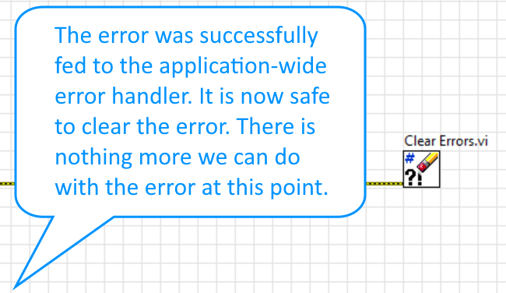
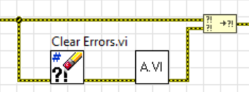
Clearing Errors
Tip #13: The Clear Errors.vi should be called with unwired specific error code to clear input (clear all errors) in only two situations:
To ensure that a VI or a group of VIs execute even if upstream error occurred. This is useful to ensure safe shutdown. The original error is propagated downstream.
After an unhandled error was fed to the application-wide error handler.

Slide 19
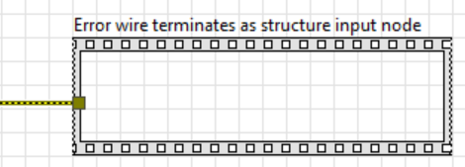
Clearing Errors
Tip #14: Clearing errors should always be done using the Clear Errors.vi.
Clear Errors.vi is the best and most self-explanatory way of clearing an error.
Never clear the error by wiring to a structure input tunnel. This is a language flaw as explained in the following LabVIEW Idea: Wiring LabVIEW error to structure input tunnel should not clear the error.
Bad

Slide 20
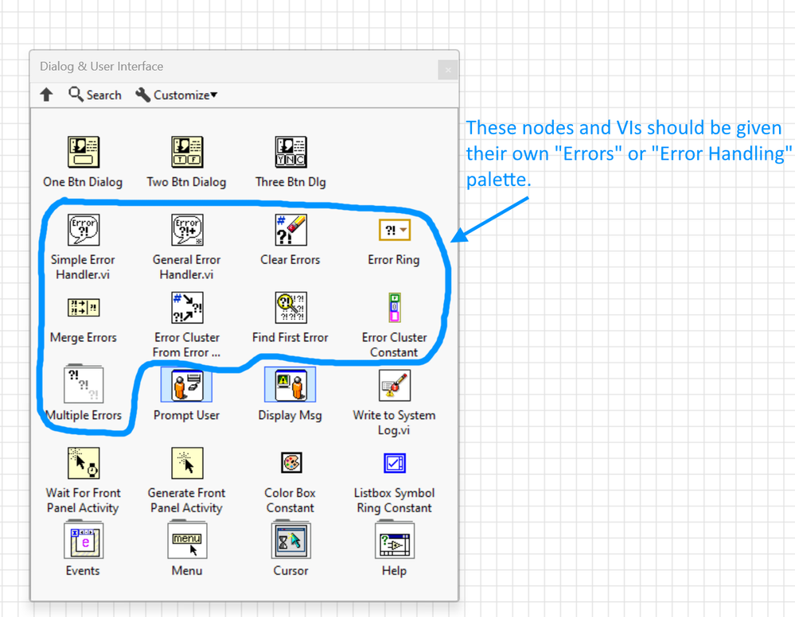
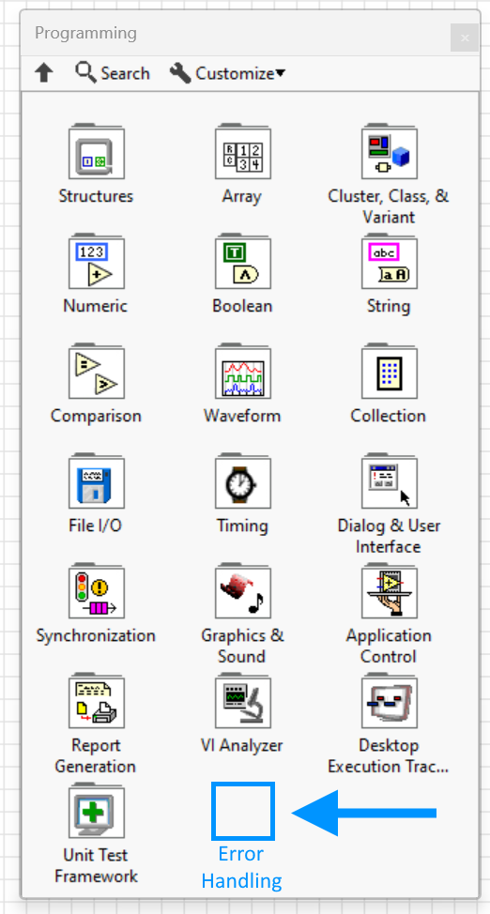
LabVIEW Idea: Error functions should be located in a dedicated palette
Notes:
Error handling is a stand-alone topic. It should have its dedicated palette.

Slide 21
Now for the most controversial part of the presentation…
Automatic Error Handling (AEH)
Notes:
Does anyone want to venture a guess as to what the most controversial part of the presentation will be?

Slide 22
Going against Darren’s advice (the prequel)
Darren Nattinger’s presentations are so good that they can be considered required reading for any LabVIEW programmer. I learned lots from Darren’s presentations over the years.
I agree with the majority of the points Darren made in the excellent What to Expect When You're Expecting an Error presentation.
I disagree with a few points, discussed next.

Slide 23
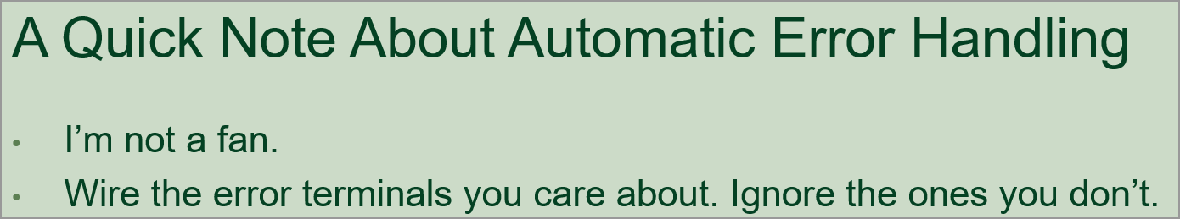

Automatic Error Handling (AEH)
Tip #15: Automatic Error Handling is a useful feature. Most VIs should use AEH.
Notes:
Screenshots with think blue border are taken from Darren’s presentation.

Slide 24
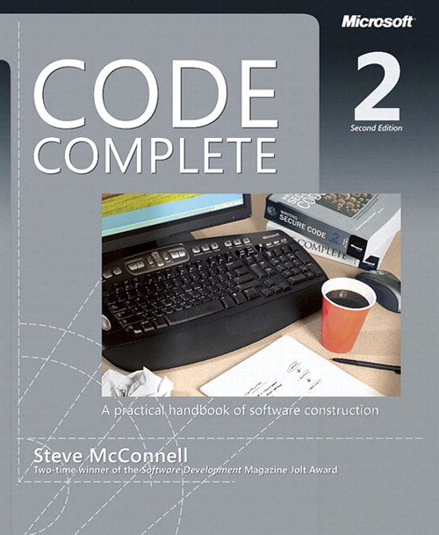
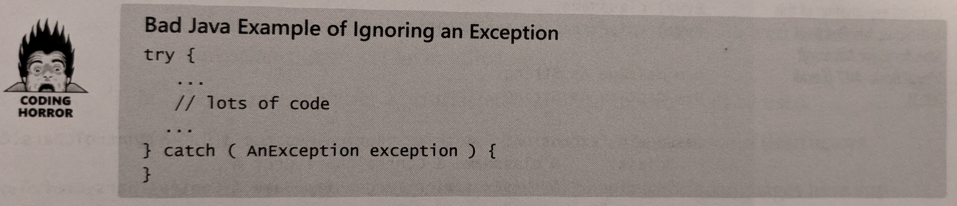
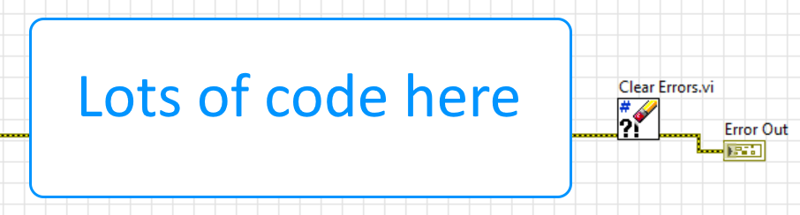
Automatic Error Handling (AEH)
Source: “Code Complete 2” by Steve McConnell, chapter 8.4 Exceptions, page 201.
Notice that the catch statement is empty. This clears any/all exceptions without any explanation. This is a Coding Horror.
In LabVIEW this is equivalent to:
This book describes numerous software development best practices. I highly recommend it.
Notes:
We have already stated that clearing errors without explanation is never recommended.
Let’s now review what AEH is and what it does.

Slide 25
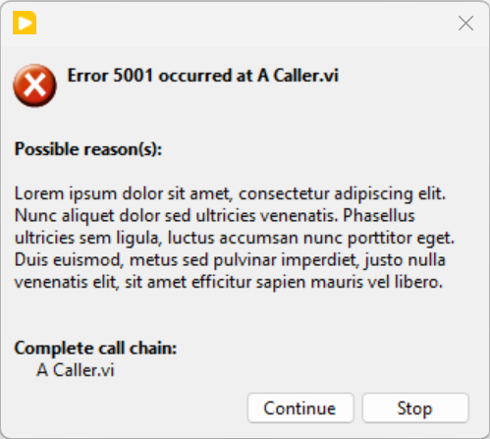
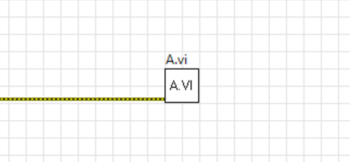
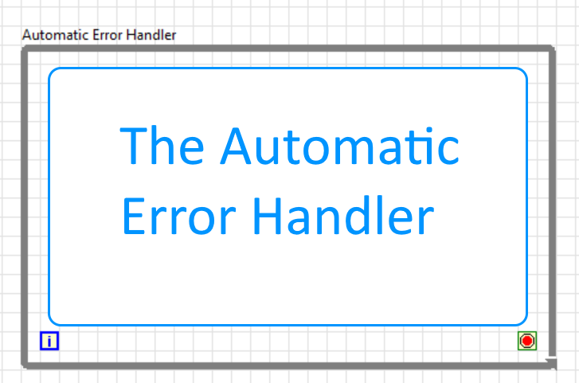
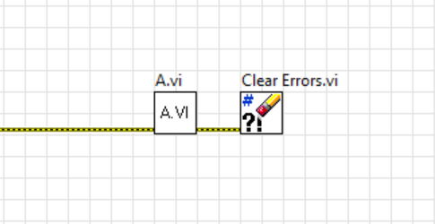
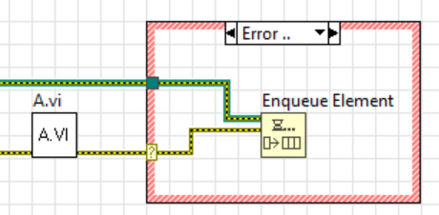
Automatic Error Handling (AEH)
AEH Disabled
AEH Enabled
Equivalent
to
Equivalent
to

Slide 26
Automatic Error Handling (AEH)
Automatic Error Handling is an insurance or a safety net.
It ensures that if an error is produced on an unwired error wire, that error will not disappear into a void. The error will be reported to you, the developer, so you can take corrective action.
Enabling AEH is a defensive programming technique. It leads to more reliable code.
To clarify
I am not proposing relying on AEH as the sole means of error handling.
All error wires should be wired. “Manual” error handling is the gold-standard.
I am proposing enabling AEH in addition to manually wiring all errors.
This way the error will be reported even in the unlikely event that a programmer forgets to manually wire.
Typical AEH workflow:
AEH detects an unhandled error.
Programmer investigates, creates local handling if necessary, manually wires the error output.
Three months pass by.
AEH detects an unhandled error.
Programmer investigates, creates local handling if necessary, manually wires the error output.
And so on…

Slide 27
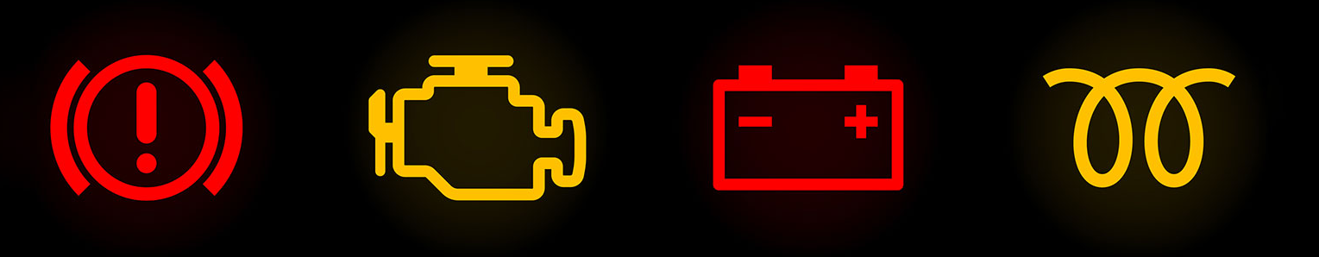
Analogies
AEH is similar to a spellchecker in a text editor
Disabling AEH is similar to disabling the spellchecker in a text editor.
It is wise to leave the spellchecker enabled even if your document currently contains no misspelled words (i.e. all your error wires are currently wired). The next sentence you write may contain a spelling error (i.e. the next VI you write may contain an unwired wire).
You can write a perfectly good book without a spellchecker.
AEH is similar to car dashboard warning lights
Disabling AEH is similar to disabling the dashboard warning lights in a car.
The car may be in perfect working order. It is still wise to leave the warning detection mechanism enabled.
You can drive hundreds of thousands of miles without this functionality.

Slide 28
Automatic Error Handling (AEH)
Automatic Error Handling is an advisor that sits out of the way most of the time.
AEH does not take anything away. It simply draws attention to unhandled errors, if they exist.
Is there any valid reason for disabling AEH?
Yes. When looking to achieve the maximum possible performance in a VI. This is a rare and specialised situation.
AEH must add a small computational burden. Anecdotally this is virtually unnoticeable, but it would be interesting to have benchmarks.
What should I do when encountering an AEH error message?
Investigate the cause of the error.
Decide if the error can be handled locally. If it can, clear only that specific error code and add explanatory message.
Manually wire the error wire so that the error is fed to the app-wide error handler.
Do not clear all errors on that wire or turn off AEH just to get rid of the AEH message.

Slide 29
Automatic Error Handling (AEH)
Can AEH be even better?
Yes, by implementing the following LabVIEW Ideas:
Custom automatic error handling callback
Whether Automatic Error Handling (AEH) is enabled or disabled should be indicated on the block diagram
Ability to enable or disable Automatic Error Handling for all project items
Honour each VI's Automatic Error Handling setting in EXE
LabVIEW is the only programming language that I am aware of whose default error handling in development (AEH enabled) is different from the default error handling in EXE (AEH disabled).

Slide 30
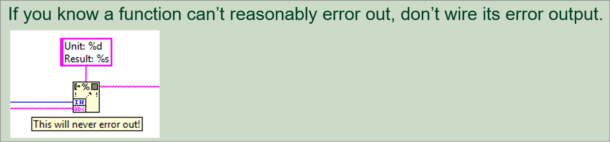
Automatic Error Handling (AEH)
“But I don’t need AEH. I wire all my Error Out terminals.”
Wiring all Error Out terminals is a best practice. Continue doing it AND enable AEH.
“I use a VI Analyzer test to detect any locations where Error Out is unwired.”
This is a best practice. Continue doing it AND enable AEH.
If a node has an Error Out terminal you must assume that it can, and it will generate errors.
There is no way of knowing which errors a node can produce. Maybe you have just been lucky.
The following idea request that the detailed help of each node should contain the full, or at least partial, set of error codes that the node can generate: List every error code a function can give out
If an error can be safely ignored you must document it in the code by using
Clear Errors.vi with specific error code and comment

Slide 31
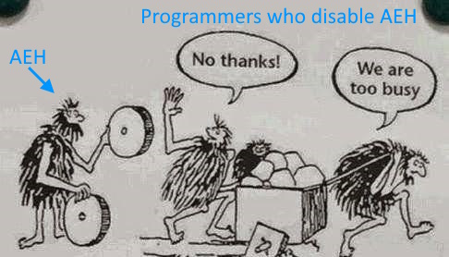
Automatic Error Handling (AEH)

Slide 32
Improvements to the LabVIEW error system
Should the LabVIEW error wire become an object or a collection of objects?
Yes, this would be a major improvement.
See the following excellent discussion: “Christopher G. Relf (crelf) - NI Week 2009 Presentation: Advanced Error Handling in LabVIEW”
https://lavag.org/topic/10150-ni-week-session-advanced-error-handling-in-labview/
https://lavag.org/topic/10741-updating-the-labview-error-handling-core/

Slide 33
Improvements to the LabVIEW error system
Are there differences between errors in LabVIEW and other languages?
The purpose of errors is the same in all languages: to communicate that an operation could not be performed.
The standardised mechanism for communicating errors in LabVIEW is the error wire.
The standardised mechanism for communicating errors in most programming languages are exceptions and the try-catch-finally structure.
C++, C#, Java, Python, Visual Basic
See the following excellent presentation that details how exceptions and the try-catch-finally structure could be applied to LabVIEW: “Nate Moehring - LabVIEW Exceptions: a paradigm shift to error handling in LabVIEW, CLA Summit 2010”
Direct link to PDF: https://www.themoehrings.com/wp-content/uploads/2010/12/LabVIEW-Exceptions.pdf

Slide 34
Resources
No. | Date | Author | Resource Name | URL
1 | August 2009 | Christopher G. Relf (crelf) | NI Week 2009 Presentation: Advanced Error Handling in LabVIEW | https://lavag.org/topic/10150-ni-week-session-advanced-error-handling-in-labview/
2 | March 2010 | Nate Moehring | LabVIEW Exceptions: a paradigm shift to error handling in LabVIEW, CLA Summit 2010 | https://www.themoehrings.com/wp-content/uploads/2010/12/LabVIEW-Exceptions.pdf
3 | July 2015 | Stobber | How would you redesign the LV error cluster | https://lavag.org/topic/19134-how-would-you-redesign-the-lv-error-cluster/
4 | October 2018 | Darren Nattinger | “What to expect when you are expecting an error” | https://www.youtube.com/watch?v=V0K4UcPDBUw and https://www.youtube.com/watch?v=UlOFcmwrsBA
5 | August 2021 | Mark Ridgley | Midlands LabVIEW User Group (MLUG): Best Practices For Error Handling in LabVIEW | https://www.youtube.com/watch?v=W1egwquZ4ow
6 | September 2022 | Wiebe Walstra | Error Handling 2.0 | https://youtu.be/vTcxuAqoSdk?si=aPyTf24_gVPnHfIg
7 | September 2024 | Petru Tarabuta | This presentation | https://github.com/RobustoSystems/LabVIEWErrorsDeepDivePresentation

Slide 35
Thank you!
Are there any questions?

